Slide 1
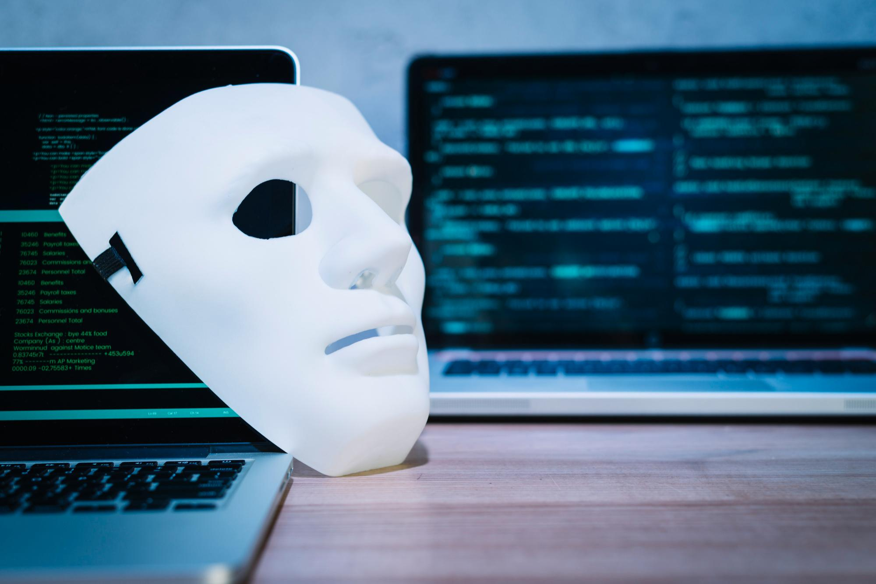
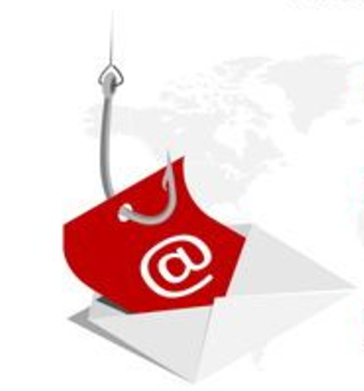
By Deepak Kumar singh
Phishing Awareness

Slide 2
01
Phishing Attack through email

Slide 3
What Is Phishing Attack
“Phishing” refers to an attempt to steal sensitive information, typically in the form of usernames, passwords, credit card numbers, bank account information or other important data in order to utilize or sell the stolen information. By masquerading as a reputable source with an enticing request, an attacker lures in the victim in order to trick them, similarly to how a fisherman uses bait to catch a fish.

Slide 4
Types Of Phishing Attack
Email Phishing
Spear Phishing
Whaling
Smishing and vishing
Angler Phishing
Angler vishing

Slide 5
1. Email Phishing :-
Most phishing attacks are sent via email. Attackers typically register fake domain names that mimic real organizations and send thousands of common requests to victims.
For fake domains, attackers may add or replace characters (e.g., my-bank.com instead of mybank.com), use subdomains (e.g., mybank.host.com), or use the trusted organization’s name as the email username (e.g., mybank@host.com).
Many phishing emails use a sense of urgency or a threat to cause a user to comply quickly without checking the source or authenticity of the email.
Email phishing messages have one of the following goals:
Causing the user to click a link to a malicious website in order to install malware on their device.
Causing the user to download an infected file and using it to deploy malware.
Causing the user to click a link to a fake website and submit personal data.
Causing the user to reply and provide personal data.

Slide 6
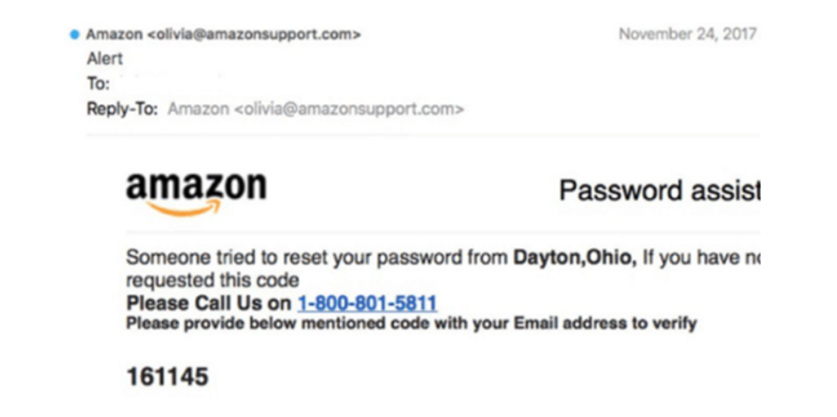
Example of email phishing
The fake domain often involves character substitution, like using ‘r’ and ‘n’ next to each other to create ‘rn’ instead of ‘m’.
In other cases, the fraudsters create a unique domain that includes the legitimate organisation’s name in the URL. The example below is sent from ‘olivia@amazonsupport.com’.
The recipient might see the word ‘Amazon’ in the sender’s address and assume that it was a genuine email.

Slide 7
2. Spear Phishing
Spear phishing includes malicious emails sent to specific people. The attacker typically already has some or all of the following information about the victim:
Name
Place of employment
Job title
Email address
Specific information about their job role
Trusted colleagues, family members, or other contacts, and samples of their writing
This information helps increase the effectiveness of phishing emails and manipulate victims into performing tasks and activities, such as transferring money.

Slide 8
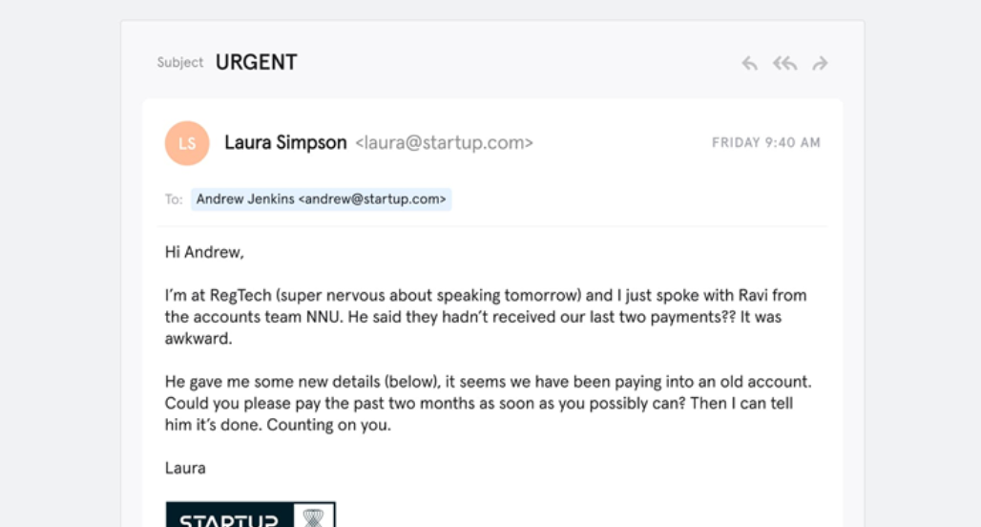
Example of Spear Phishing
The fraudster has the wherewithal to address the individual by name and (presumably) knows that their job role involves making bank transfers on behalf of the company.
The informality of the email also suggests that the sender is a native English speaker and creates the sense that this is a real message rather than a template.

Slide 9
3. whaling
Whaling attacks target senior management and other highly privileged roles. The ultimate goal of whaling is the same as other types of phishing attacks, but the technique is often very subtle. Senior employees commonly have a lot of information in the public domain, and attackers can use this information to craft highly effective attacks.
Typically, these attacks do not use tricks like malicious URLs and fake links. Instead, they leverage highly personalized messages using information they discover in their research about the victim. For example, whaling attackers commonly use bogus tax returns to discover sensitive data about the victim and use it to craft their attack.

Slide 10
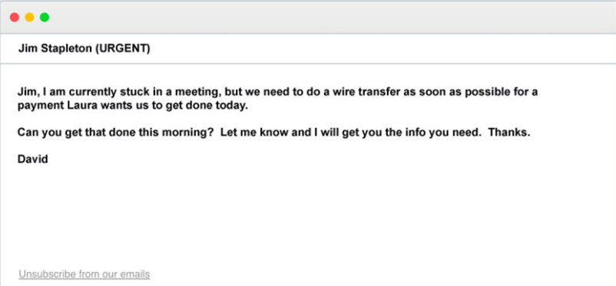
Example of Whaling
Emails such as the right might not be as sophisticated as spear phishing emails, but they play on employees’ willingness to follow instructions from their boss.
Recipients might suspect that something is amiss but are too afraid to confront the sender to suggest that they are being unprofessional.

Slide 11
4. Smishing and Vishing
This is a phishing attack that uses a phone instead of written communication. Smishing involves sending fraudulent SMS messages, while vishing involves phone conversations.
In a typical voice phishing scam, an attacker pretends to be a scam investigator for a credit card company or bank, informing victims that their account has been breached. Criminals then ask the victim to provide payment card information, supposedly to verify their identity or transfer money to a secure account (which is really the attacker’s).
Vishing scams may also involve automated phone calls pretending to be from a trusted entity, asking the victim to type personal details using their phone keypad.

Slide 12
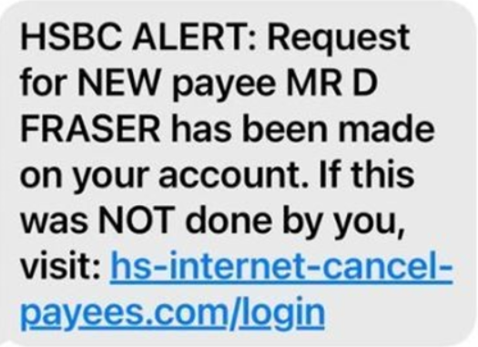
Example of Phishing & Vishing
One of the most common smishing pretexts are messages supposedly from your bank alerting you to suspicious activity.
In this example, the message suggests that you have been the victim of fraud and tells you to follow a link to prevent further damage. However, the link directs the recipient to a website controlled by the fraudster and designed to capture your banking details.

Slide 13
5. Angler Phishing
These attacks use fake social media accounts belonging to well-known organizations. The attacker uses an account handle that mimics a legitimate organization (e.g., “@pizzahutcustomercare”) and uses the same profile picture as the real company account.
Attackers take advantage of consumers’ tendency to make complaints and request assistance from brands using social media channels. However, instead of contacting the real brand, the consumer contacts the attacker’s fake social account.
When attackers receive such a request, they might ask the customer to provide personal information so that they can identify the problem and respond appropriately. In other cases, the attacker provides a link to a fake customer support page, which is actually a malicious website.

Slide 14
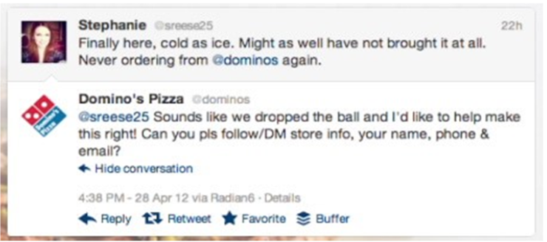
Example of Angler Phishing
As this example demonstrates, angler phishing is often made possible due to the number of people containing organisations directly on social media with complaints.
Organisations often use these as an opportunity to mitigate the damage – usually by giving the individual a refund.
However, scammers are adept at hijacking responses and asking the customer to provide their personal details. They are seemingly doing this to facilitate some form of compensation, but it is instead done to compromise their accounts.

Slide 15
Tips to protect yourself from Phishing emails.
The most successful phishing emails are carefully constructed to look identical to messages received by well-known companies or senders. These messages are often difficult to distinguish from real emails. Keep an eye out for these red flags when scanning your inbox for phishing scams:
Attractive, “To-Good-To-Be-True” Offers: If an email is promising you something too good to be true, it probably is. These attractive offers are designed to immediately grab your attention and detract from other details within the message. If you are offered a large sum of money, a new phone, vacation, car, or other prizes, verify the sender or just ignore the message.
False Sense of Urgency: If an email demands that you act quickly, or presents a limited-time opportunity that failure to claim will result in a severe, negative action, take your time to read and understand the message. A reputable organization, including government entities, will not contact you via email threatening a consequence if you do not comply with the message guidelines. Call the sender’s business directly to discuss the email message using a verifiable phone number, never reply to these emails or use the contact information within the message.

Slide 16
Tips to protect yourself from Phishing emails.
Fake Hyperlinks: If an email looks suspicious, ensure that any websites or links provided are going to a safe website. Or skip slicking on email links completely and visit the entity’s website you are familiar with. A common tactic used by phishing scammers is link manipulation where a malicious hyperlink is inserted to look like it belongs to the organization sending the email. Often these fake URLs will be misspelled to deceive you. Other times, the fake link will be disguised as a text box, asking you to “Click Here.” Make sure to hover over the text box to view the actual web address.
Corrupt Attachments: If you received an attachment from a questionable email, do not open it without first confirming the documents with the sender. Similar to hyperlinks, attachments in phishing emails usually contain malicious viruses or ransomware.

Slide 17
How to Avoid Phishing Scams ?
While scam tactics and technology are always updating, there are some simple proactive steps you can take to stay safe from phishing.
Consider these steps to help you spot phishing attempts:
Add spam filters to your email.
Never email personal or financial information without proper security protocols.
Do not respond to messages seeking personal information via email.
Call the sender directly to verify if a message you received is legitimate.
Check that the website you are visiting is secure. Look for a lock icon or an address that begins with “https:” indicating that the site is secure.

Slide 18
02
Phishing Attack through website

Slide 19
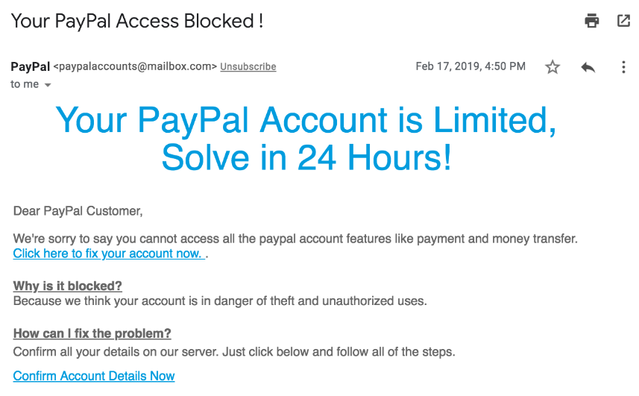
Website Phishing Attack
To understand better “Website Phishng Attack” lets take example and try to understand that ;
A phishing attack typically starts
With an email that claims to be from
a legitimate website, like a banking
website or online store:
An email that claims to be from PayPal

Slide 20
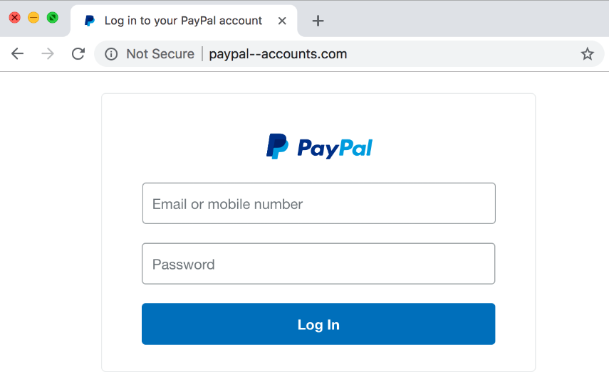
Website Phishing Attack
The goal of the email is to obtain private data from the user, so it either asks the recipient to reply with personal information or it links to a website that looks remarkably like the original site
If the user is convinced and enters private details on the site, that data is now in the hands of the attacker! If the user filled in login details, they can then use those credentials to log in to the real website, or if the user provided credit card details, they can use the credit card to make purchases anywhere.
A website that claims to be a PayPal login screen

Slide 21
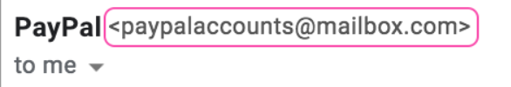
Website Phishing Attack
Signs of a phishing attack :
Suspicious email address
Phishing emails will often come from addresses at domains that don't belong to the legitimate company.
Email looks like it's from PayPal but is actually from mailbox.com.
a legitimate email address is not a guarantee that an email is 100% safe. Attackers might have figured out a way to spoof the legitimate email address or hacked their way into control over the actual email.
A website that claims to be a PayPal login screen

Slide 22
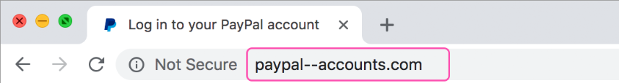
Website Phishing Attack
Suspicious URL
Phishing emails will often link to a website with a URL that looks legitimate but is actually a website controlled by the attacker.
Attackers use a variety of strategies to make tempting URLs:
Misspellings of the original URL or company name. For example, "goggle.com" instead of "google.com".
A spelling that uses similar looking characters from other alphabets. For example, "wikipediа.org" versus "wikipedia.org". The "e" and the "a" are actually different characters in those two domains.
Subdomains that look like the domain name. For example, "paypal.accounts.com" instead of "accounts.paypal.com". PayPal owns the second domain, but they have no control over the first.
A different top level domain (TLD). For example, "paypal.io" versus "paypal.com". Popular companies try to buy their domain with the most common TLDs, such as ".net", ".com", and ".org", but there are hundreds of TLDs out there.
URL has "paypal" in it, but isn't PayPal's actual domain.URL has "paypal" in it, but isn't PayPal's actual domain.

Slide 23
Website Phishing Attack
Even if an attacker hasn't found a similar looking URL to host their malicious webpage, they can still try to disguise the URL in the HTML.
Consider this very legitimate looking text:
Visit www.paypal.com to change your password.
Now try clicking the link. You didn't land on PayPal, did you? That's because the text of a link isn't the same as the destination of the link.

Slide 24
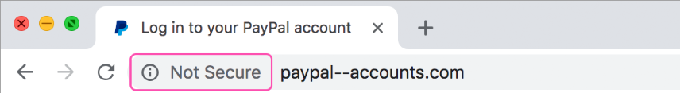
Website Phishing Attack
Non-secured HTTP connections
Any website that is asking you for sensitive information should be using HTTPS to encrypt the data sent over the Internet.
Phishing websites don't always go through the extra effort to use HTTPS.
However, according to a report, more than two-thirds of all phishing websites used HTTPS in 2019, so a secured URL does not necessarily equate to a legitimate URL.
URL isn't secured over HTTPS, so browser displays "Not secure".

Slide 25
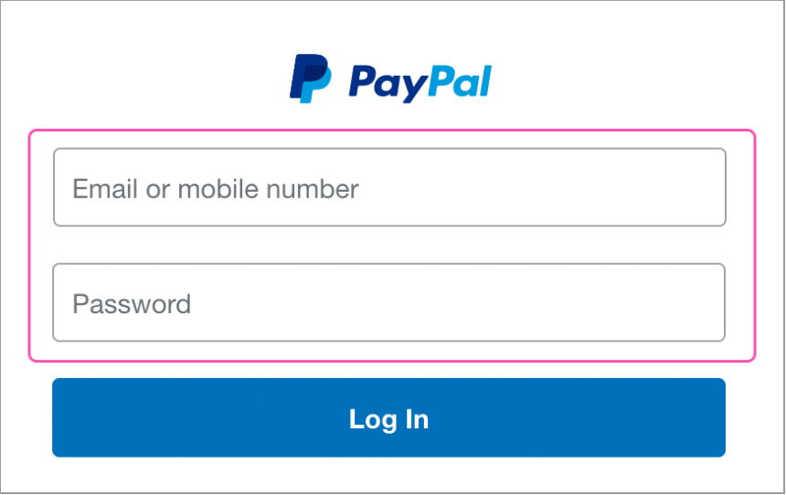
Website Phishing Attack
Requests for sensitive information
Phishing emails will often ask you to either reply with personal information or fill out a form on a website. Most legitimate companies do not need you to verify personal information after the original account creation.

Slide 26
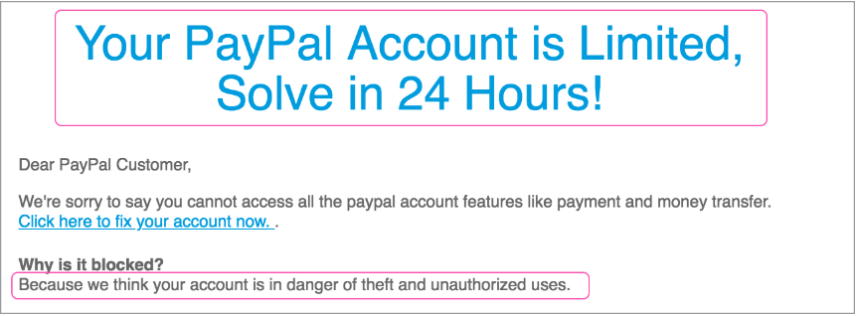
Website Phishing Attack
Urgency and scare tactics
Phishing emails use psychological manipulation to lower our guard and get us to respond quickly without thinking through the consequences.

Slide 27
Website Phishing Attack
Handling a phishing attack
Every phishing scam will vary in its sophistication, so some emails may be very obviously fake while other emails can be incredibly convincing.
If you ever suspect an email is a phishing attack, do not click on any links or download any attached files.
Find another way to contact the supposed sender to see if the email is legit. If the email's from a company, you can search online for their phone number. If it's from a friend or colleague, you can message them or give them a call.

Slide 28
Website Phishing Attack
5 Ways to Protect Your Organization from Phishing Attacks
Here are a few ways your organization can reduce the risk of phishing attacks.
1. Employee Awareness Training
It is paramount to train employees to understand phishing strategies, identify signs of phishing, and report suspicious incidents to the security team.
Similarly, organizations should encourage employees to look for trust badges or stickers from well-known cyber security or antivirus companies before interacting with a website. This shows that the website is serious about security and is probably not fake or malicious.
2. Deploy Email Security Solutions
Modern email filtering solutions can protect against malware and other malicious payloads in email messages. Solutions can detect emails that contain malicious links, attachments, spam content, and language that could suggest a phishing attack.
Email security solutions automatically block and quarantine suspicious emails and use sandboxing technology to “detonate” emails to check if they contain malicious code.

Slide 29
Website Phishing Attack
3. Make Use of Endpoint Monitoring and Protection
The increasing use of cloud services and personal devices in the workplace has introduced many new endpoints that may not be fully protected. Security teams must assume that some endpoints will be breached by endpoint attacks. it is essential to monitor endpoints for security threats and implement rapid remediation and response on compromised devices.
4. Conduct Phishing Attack Tests
Simulated phishing attack testing can help security teams evaluate the effectiveness of security awareness training programs and help end users better understand attacks. Even if your employees are good at finding suspicious messages, they should be tested regularly to mimic real phishing attacks. The threat landscape continues to evolve, and cyberattack simulations must also evolve.
5. Limit User Access to High-Value Systems and Data
Most phishing methods are designed to trick human operators, and privileged user accounts are attractive targets for cybercriminals. Restricting access to systems and data can help protect sensitive data from leakage. Use the principle of least privilege and only give access to users who absolutely need it.

Slide 30
References
https://www.checkpoint.com/cyber-hub/threat-prevention/what-is-phishing/
https://www.itgovernance.eu/blog/en/the-5-most-common-types-of-phishing-attack
https://www.imperva.com/learn/application-security/social-engineering-attack/
https://www.khanacademy.org/computing/computers-and-internet/xcae6f4a7ff015e7d:online-data-security/xcae6f4a7ff015e7d:cyber-attacks/a/phishing-attacks#:~:text=A%20phishing%20attack%20is%20an,UsersR3alP%40ssword%22%20filled%20in.

Slide 31
AWESOME WORDS

